Slide 1
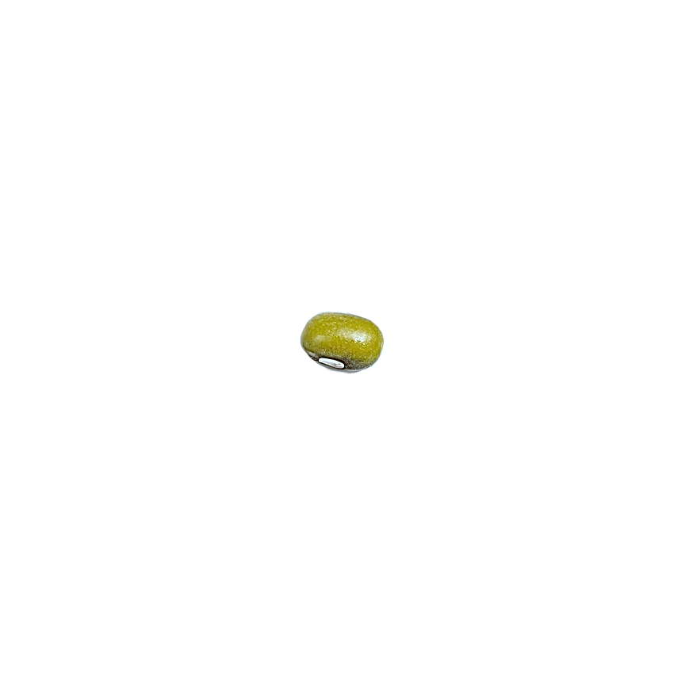
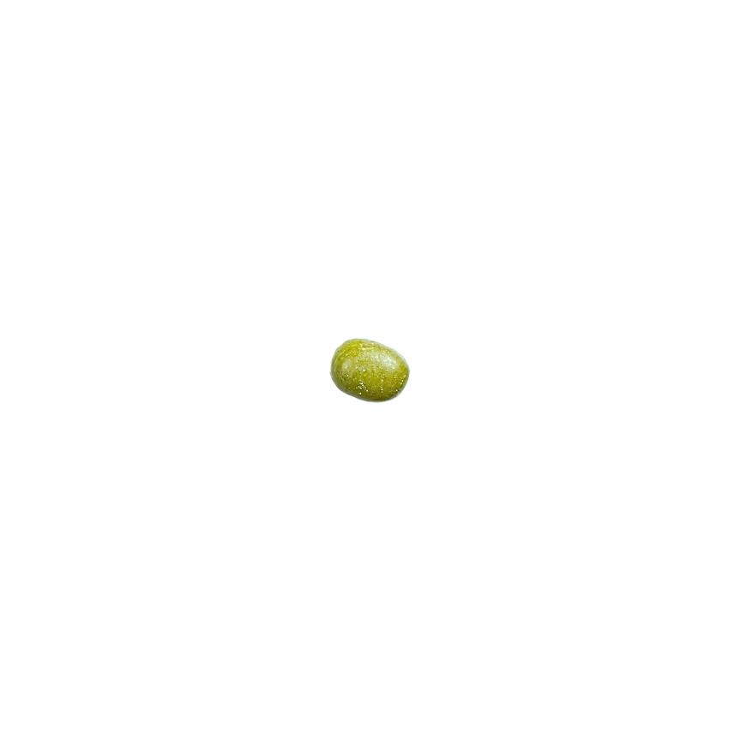
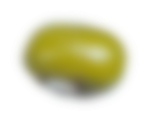
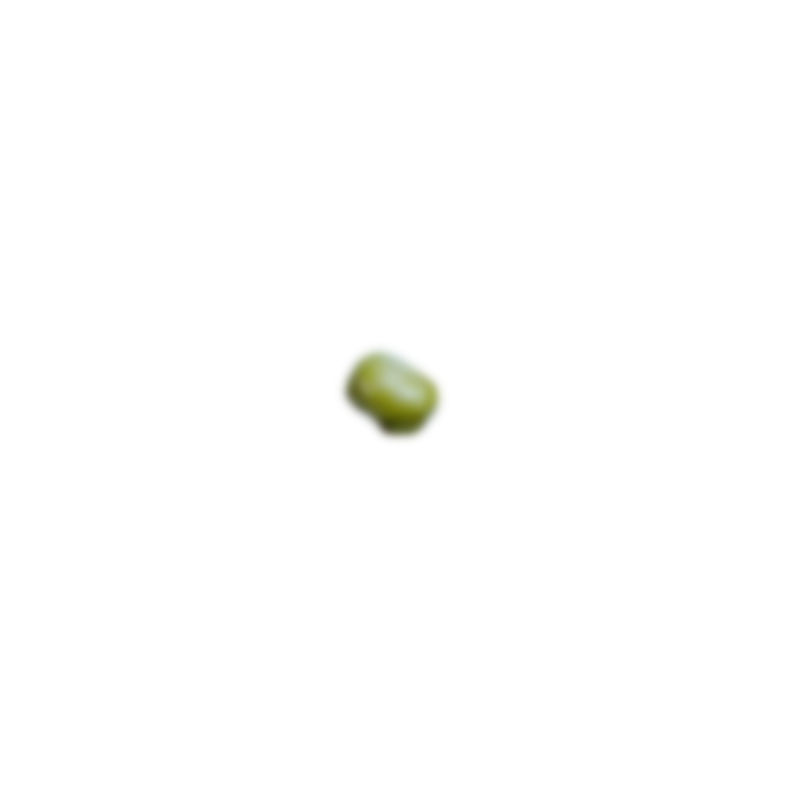
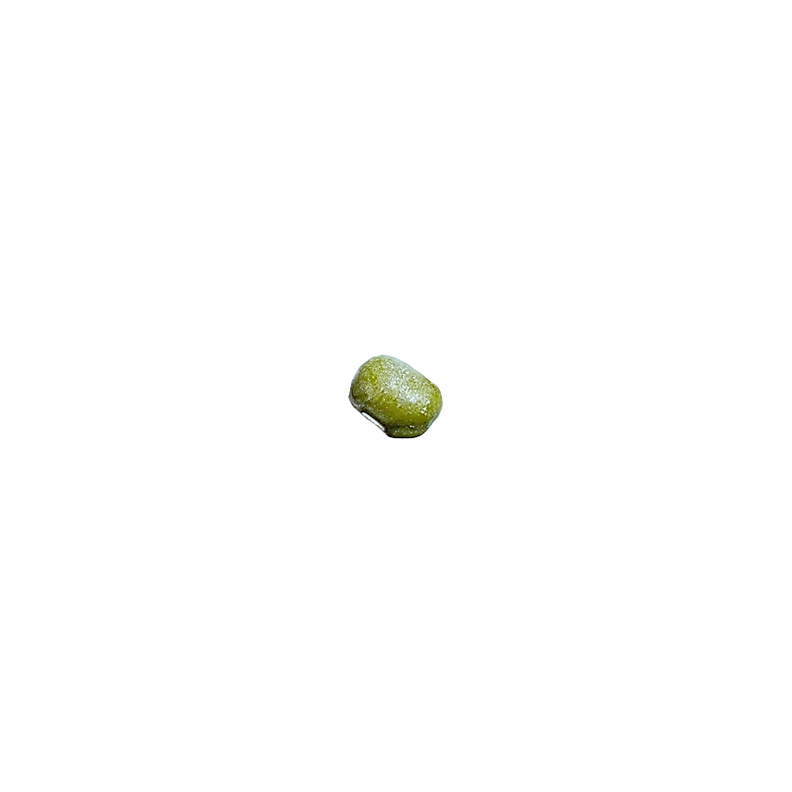
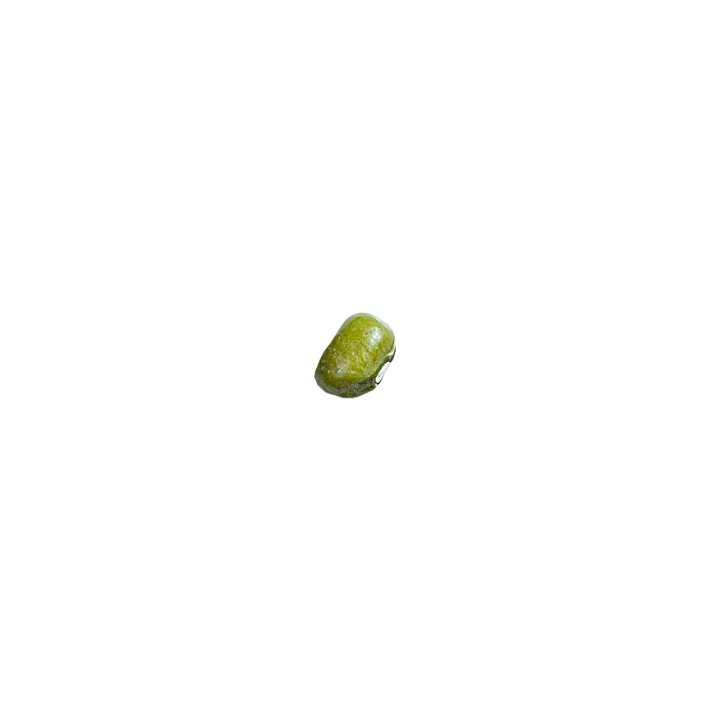
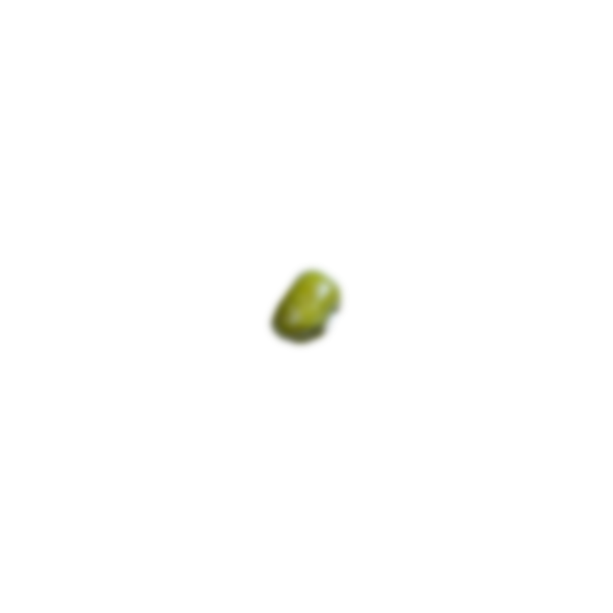
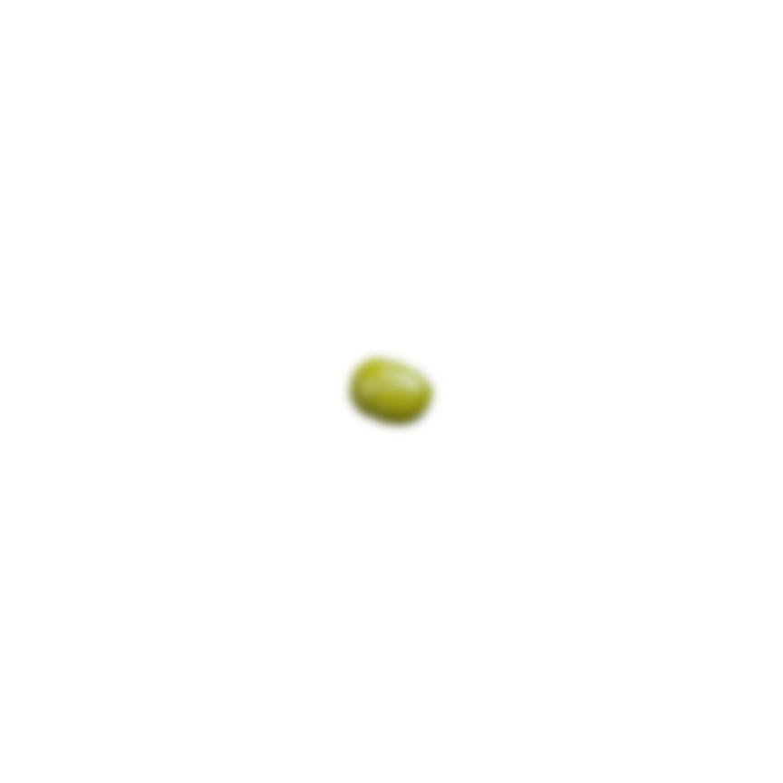
MONGODB

Slide 2
We will be able to…
1
Define what a database is
2
Differentiate SQL from NO-SQL
3
Describe what mongoDB is
4
Create a database using mongoDB Atlas

Slide 3
db means
database.

Slide 4
let me store your data. I’ll make
it safe

Slide 5
SQL
My data are organized through tables. I love relationships!
NO-SQL
Tablesssssssssssssss? One folder is enough to put all my data

Slide 6
“
SQL
My data are organized through tables. I love relationships!
NO-SQL
Tablesssssssssssssss? One folder is enough to put all my data
Notes:
SQL similar to Google Sheets
Uses columns and rows
Tabs as Tables

Slide 7
SQL
My data are interrelated through my tables. I love making connections!
NO-SQL
Tablessssssssssss? Oh, please. One document is enough to put my data
“

Slide 8


Slide 9
mongoDB manages database
DBMS
NO-SQL
data are stored in documents
mongoDB

Slide 10
GUESS THE LOGO!
GUESS THE LOGO!
GUESS THE LOGO!
GUESS THE LOGO!

Slide 11



GUESS THE LOGO!
GUESS THE LOGO!
GUESS THE LOGO!
GUESS THE LOGO!

Slide 12
GUESS THE LOGO!
GUESS THE LOGO!
GUESS THE LOGO!
GUESS THE LOGO!
Notes:
Tinder

Slide 13
GUESS THE LOGO!
GUESS THE LOGO!
GUESS THE LOGO!
GUESS THE LOGO!
Notes:
Uber

Slide 14
GUESS THE LOGO!
GUESS THE LOGO!
GUESS THE LOGO!
GUESS THE LOGO!
Notes:
AirBnB

Slide 15

GUESS THE LOGO!
GUESS THE LOGO!
GUESS THE LOGO!
GUESS THE LOGO!
Compass
Atlas
PLATFORM
Desktop App
PLATFORM
Cloud Service
DEPLOYMENT
Local Machine
DEPLOYMENT
Cloud

Slide 16
Compass
Atlas
PLATFORM
Desktop App
PLATFORM
Cloud Service
DEPLOYMENT
Local Machine
DEPLOYMENT
Cloud

Slide 17
Compass
Atlas
PLATFORM
Desktop App
PLATFORM
Cloud Service
DEPLOYMENT
Cloud
DEPLOYMENT
Local Machine

Slide 18
Compass
Atlas
PLATFORM
Desktop App
PLATFORM
Cloud Service
DEPLOYMENT
Local Machine
DEPLOYMENT
Cloud

Slide 19
Atlas
Compass
PLATFORM
Cloud Service
PLATFORM
Desktop App
DEPLOYMENT
Local Machine
DEPLOYMENT
Cloud

Slide 20
Wrapping things up!
1
Define what a database is
2
Differentiate SQL from NO-SQL
3
Describe what mongoDB is
4
Create a database using mongoDB Atlas

